Slide 1
BCR Gravel/Dirt Brevets & Permanents
Creating more opportunities to ride!

Slide 2
Rationale
generally safer than being on paved roads with traffic
something new to try for existing members, to keep things fresh
a possible entrée for new members
BCR members are already riding more unpaved distance, whether on permanents, their own rides, or non-BCR gravel events

Slide 3
Existing Examples
Audax Australia (web link)
RUSA
(weblink)
.

Slide 4
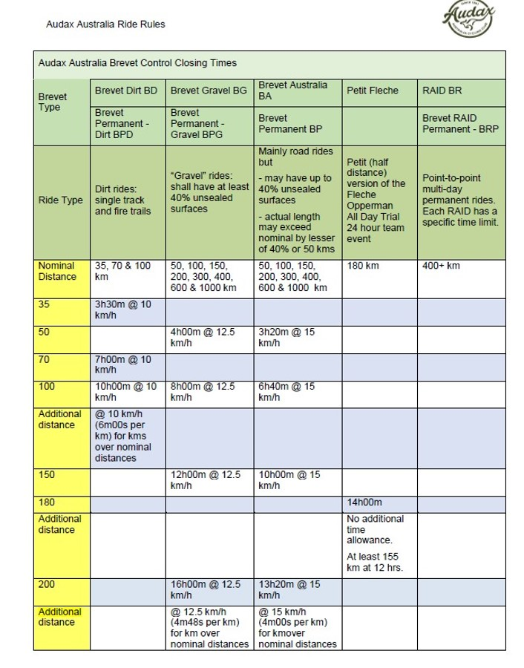
Audax Australia Key Points

Slide 5
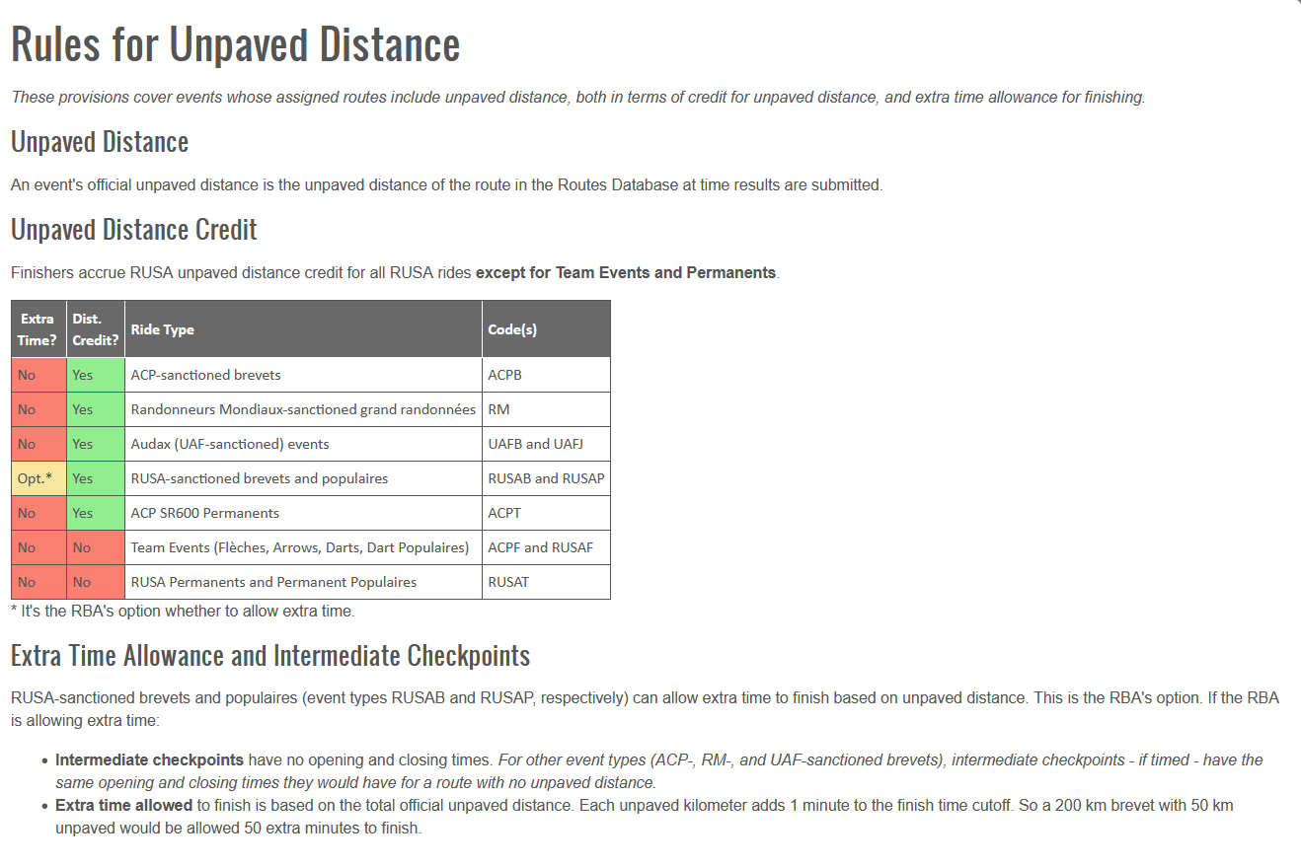
RUSA
Key Points

Slide 6
What has been asked so far
Do these events work with our current bylaws-Yes
Does our current insurance cover these events-Yes
Could Permanents be able to start ASAP-Yes
  The rides would need a special designation in the title to recognize them as Gravel or Dirt for the database.

Slide 7
How to Review the Information
BCR Google Group’s Link
Link on Facebook page
Link on Web Page

Slide 8
Where do we go from here?
Form a small volunteer committee of interested club members to formalize a plan (BCR Gravel Initiative?)

Slide 9
Sign Up
Sign up here today with either Dug or myself
Email your questions and willingness to be part of this initiative by emailing us here, directors@randonneurs.bc.ca

